Slide 1
America in the World
Stephen Burdsall, Colin Sauers, Gabby Gutierrez, Lauren Dougherty, Mike Paulosky

Slide 2
A Hotter Cold War
Trend One: Unprecedented Chaos
Arms Build Up
Fall of Berlin Wall
USSR Breakup
al-Qaeda bombs World Trade Center (1993)
al-Qaeda bombs World Trade Center and Pentagon (2001)
Arab Spring
Trend Two: Proaction
Iran- Contra Affair
US Invades Iraq
Last combat Troops withdrawn from Iraq
Trend Three: Reaction
Persian Gulf War
UN Peacekeeping Forces in Bosnia
US and Allies invade Afghanistan
Osama bin Laden Killed

Slide 3
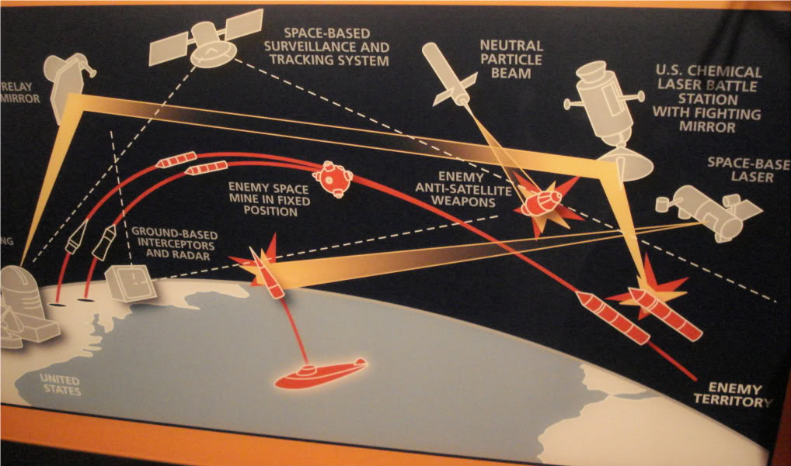
Ronald Reagan begins arms build up (1980)
“Star Wars”
Strategic Defense Initiative to shield the U.S. from nuclear missile attacks
Modernize WWII battleships
Most of the nation’s current firepower is a legacy of the Reagan years

Slide 4
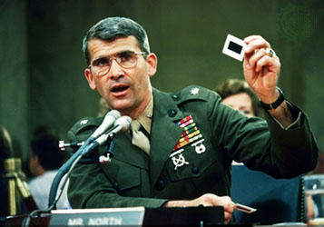
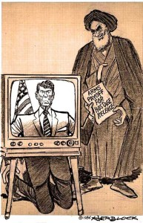
Iran-Contra Affair (1985)
Secret arms sale to Iran during embargo
Congress restricts CIA abilities to aid Contras in Nicaragua
Lieutenant Colonel Oliver North funneled money from arms deal to support Contras
Reagan's approval ratings manage to rebound despite allegations

Slide 5
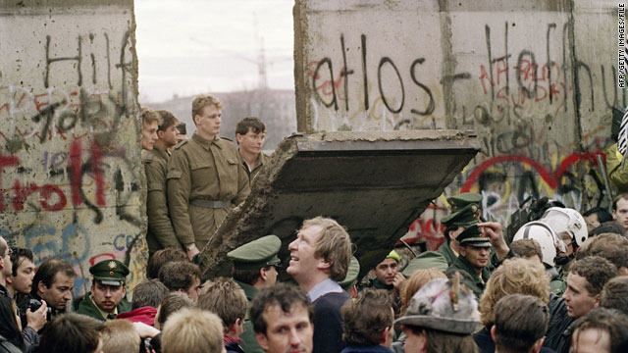
Berlin Wall comes down (1989)
Stood as a marker of Soviet power/structure
Citizens were free to cross beginning Nov. 9th 1989
Some crossed freely, others with hammers and picks chipping away at the wall as they crossed

Slide 6
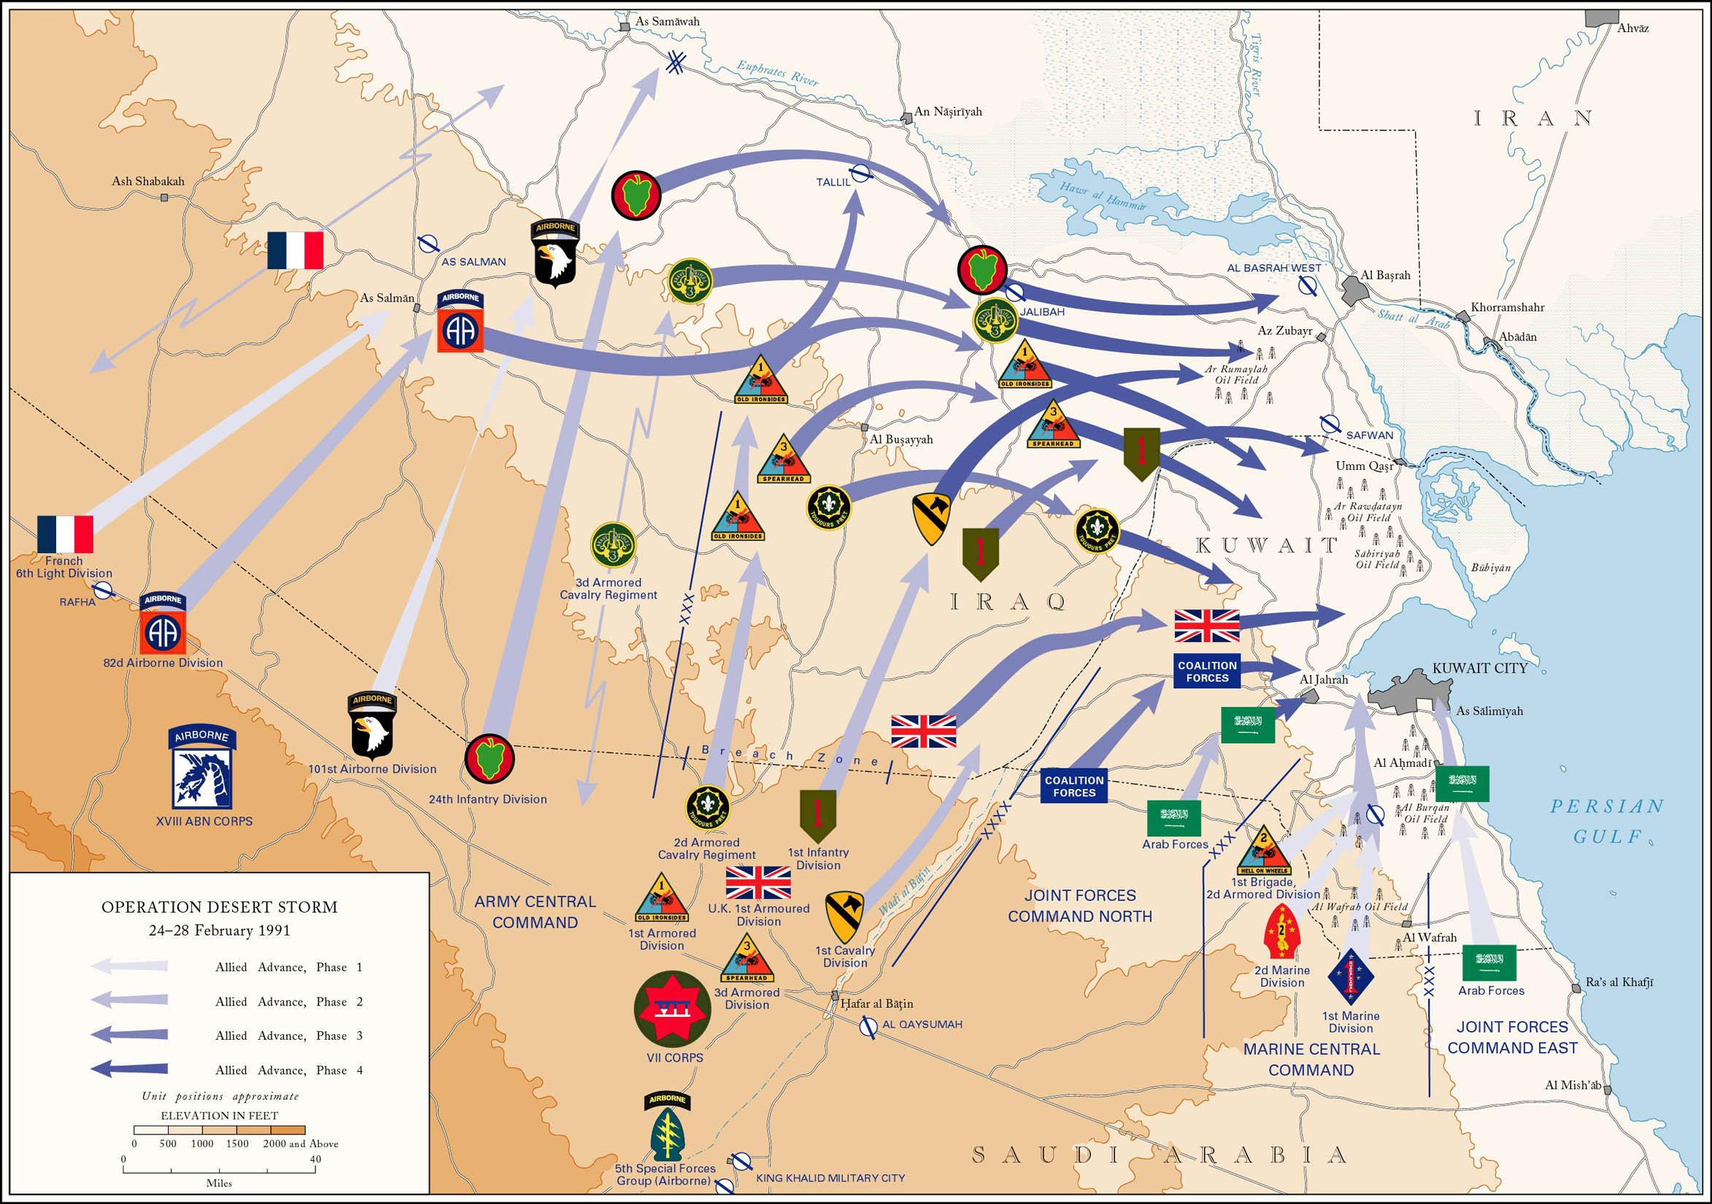
Persian Gulf War (1990-1991)
Iraq: Saddam Hussein invades Kuwait
Saudi Arabia/ Egypt ask for US help
Operation Desert Storm: US air offensive
US cease fire: President Bush and Kuwait surrender
Out of Kuwait (victory for coalition) v failed to end power of Hussein (Baghdad) and Iraq War (2003) v damage in Kuwait/Iraq

Slide 7
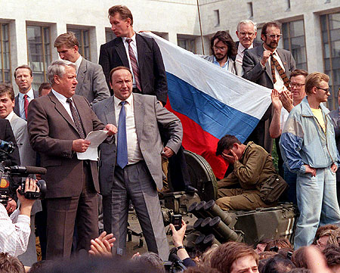
USSR breaks apart (1990)
Hammer and sickle flag lowered for the last time over the Kremlin Dec. 25th 1991
End of 20th century warfare

Slide 8
Al Qaeda bombs World Trade Center (1993)
On Friday February 26th, 1993, a bomb went off in the World Trade Center
In parking garage
6 killed, 1042 injured
FBI investigation revealed it was a terrorist attack
4 men were convicted
First ever terrorist attack on US soil
Head was Ramzi Yousef
Wanted to avenge his people

Slide 9
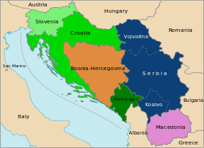
UN peacekeeping forces in Bosnia
Socialist Federal Republic of Yugoslavia-communist nation SouthEastern Europe with claimed impartiality to USSR and U.S.
Full of many different Slavic ethnic groups-- Serbs, Albanians, Roma (also muslims)
1991 Serbia and Croatia declared independence. Yugoslav government tried to forcefully maintain unity--beginning of Yugoslav Wars.

Slide 10
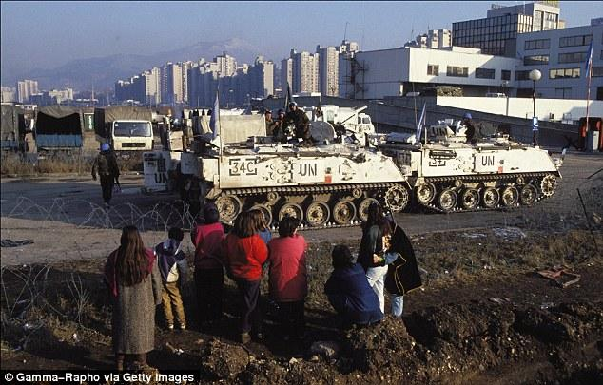
UN Peacekeeping Forces in Bosnia (cont.)
United Nations Protection Force assembled 1992 in midst of the Croatian War for Independence
War in Bosnia broke out in 1993 between Bosniaks and Croats
Civilians targeted, mines rampant, ethnic genocide
UN Forces (UNPROFOR) sent to protect civilians lives and attempt to end war
1994-1995 role was to monitor ceasefire, help rebuild infrastructure
Federation of Bosnia and Herzegovina
In Sarajevo, 1993

Slide 11
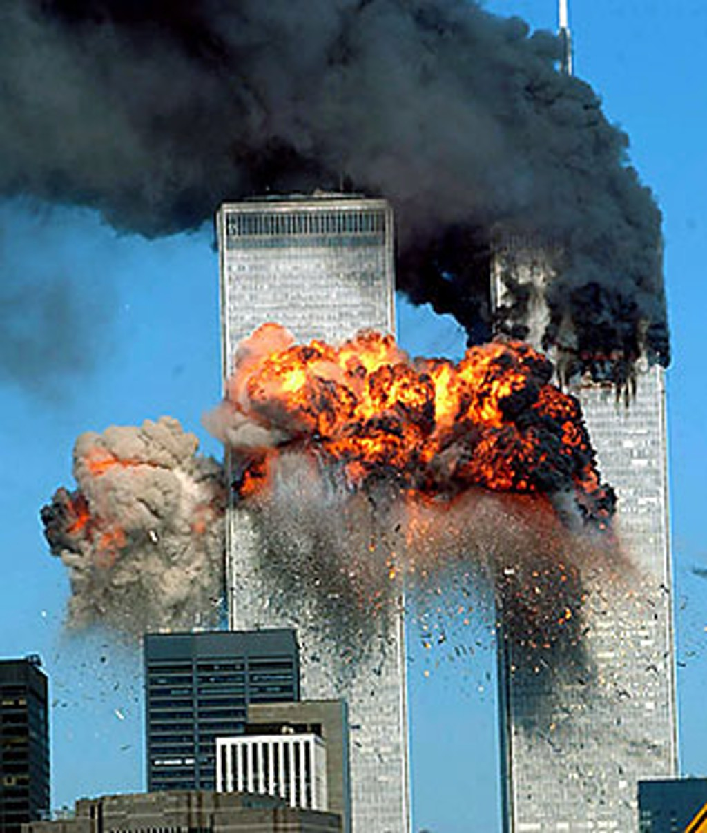
Al Qaeda Attacks World Trade Center and Pentagon (2001)
September 11, 2001
Attacked four airliners and suicide attacks because of involvement in their homeland
World Trades Center, Pentagon, and field in PA
Want to immediately end terrorism
Defined Bush’s presidency
First time America was attacked on the homeland
Horror for years to come and still moment of silence for memories

Slide 12
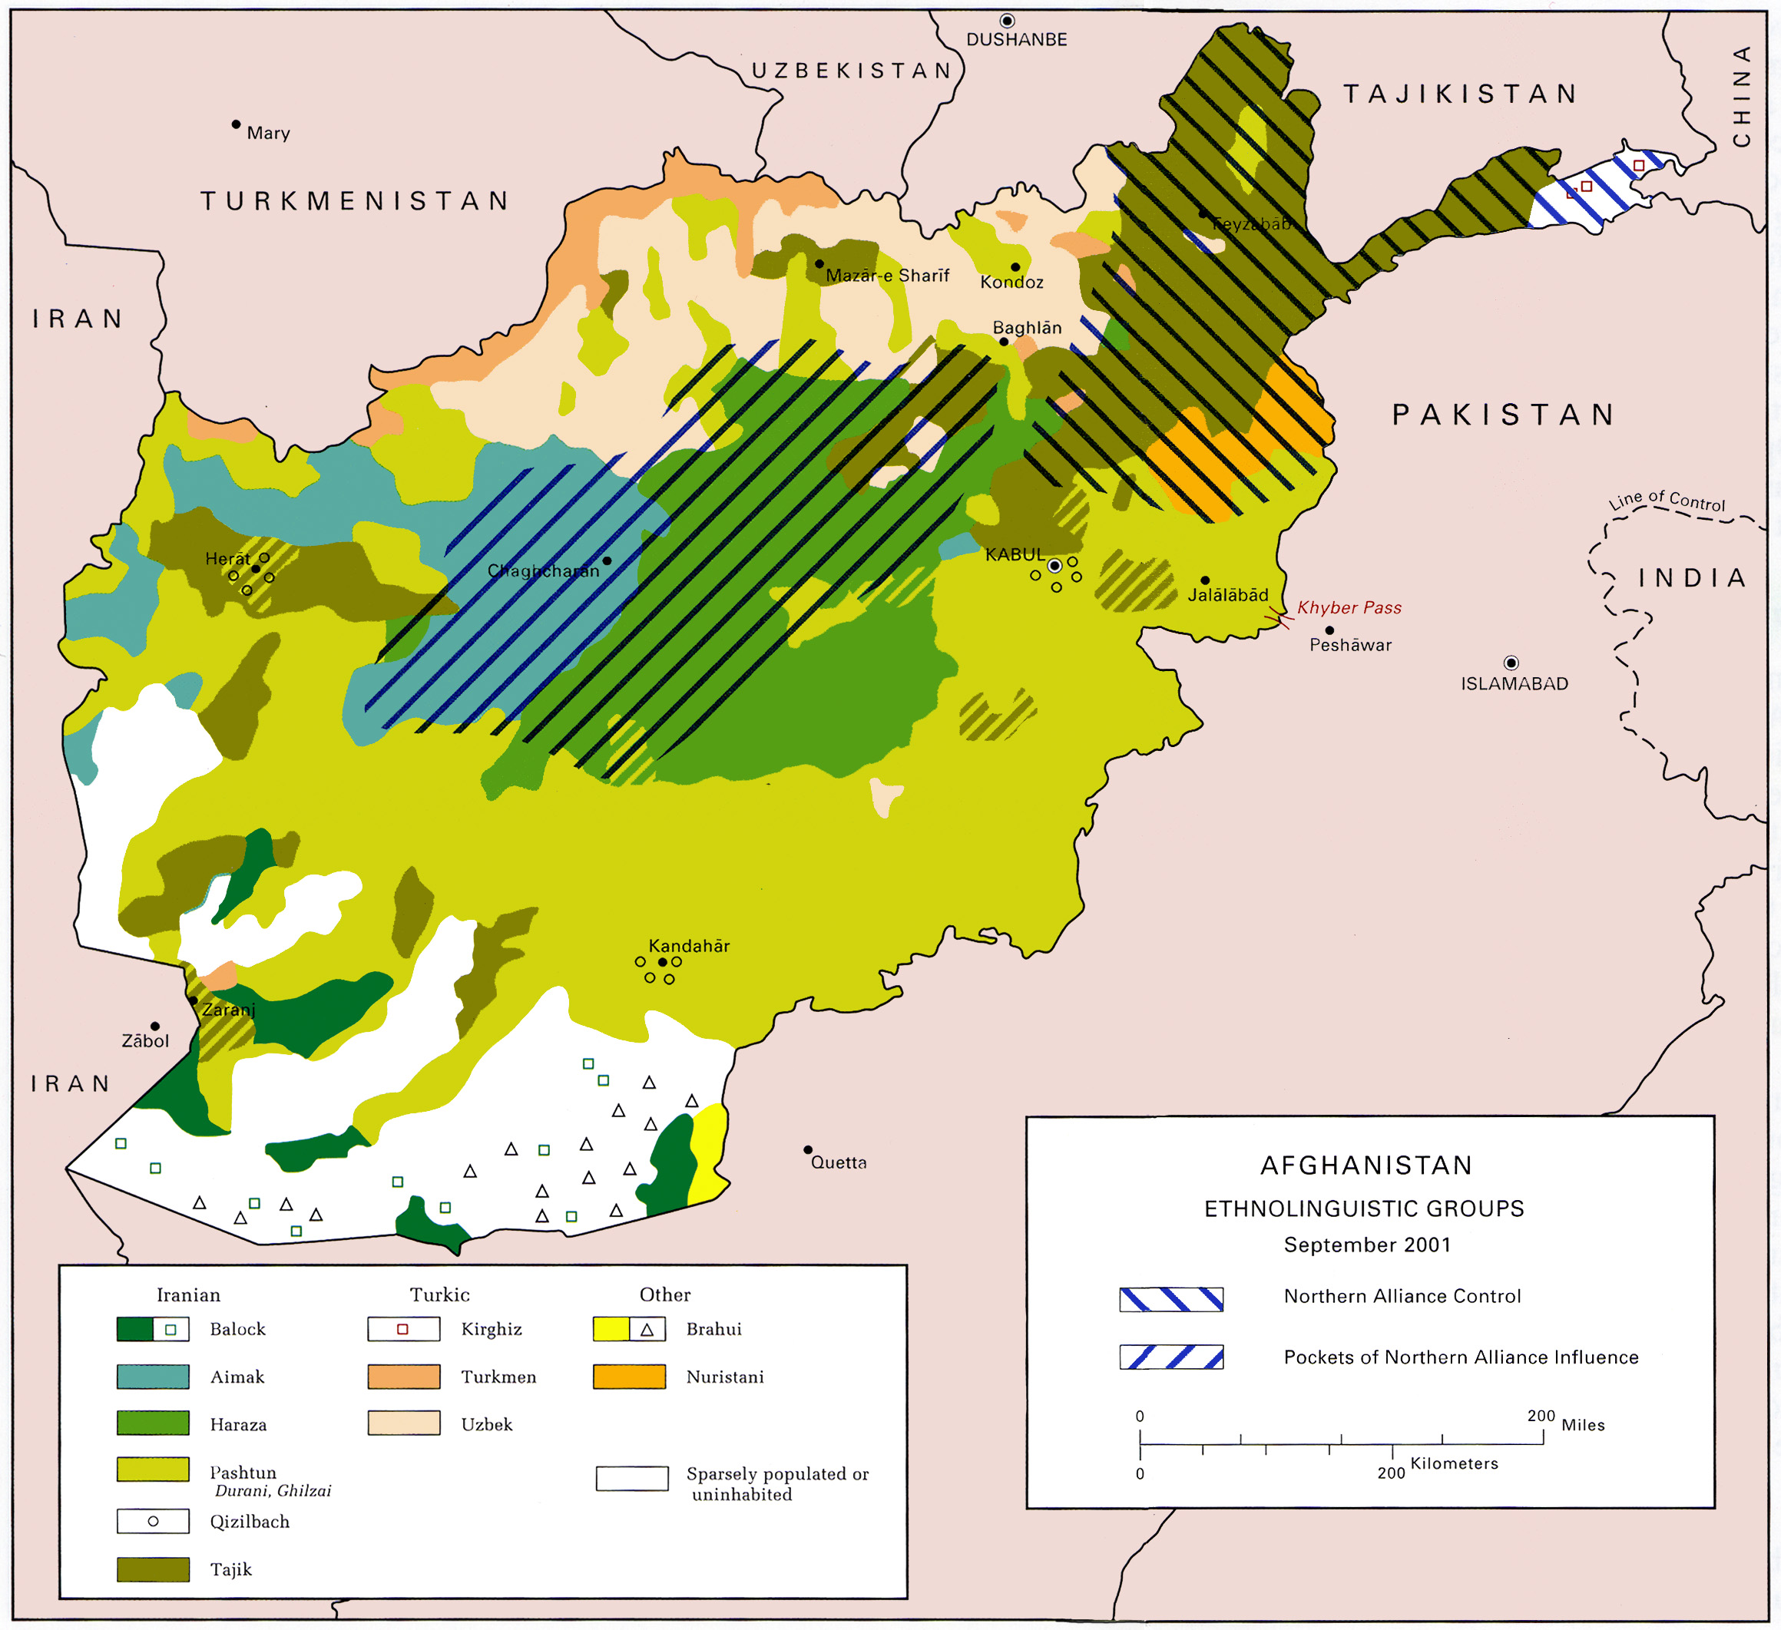
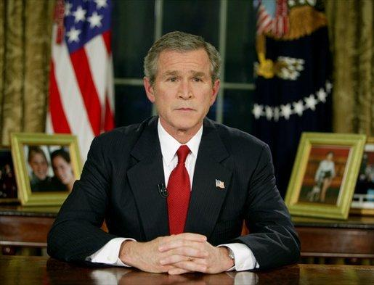
United States and Allies Invade Afghanistan
The invasion of Afghanistan was a reaction to 9/11
Was due to US belief about Osama Bin Laden
Bush launched a full assault on Afghanistan
Wanted to prevent another terrorist attack from ever occurring on U.S. soil
Crush Al-Qaeda
Was ultimately an unsuccessful war
Bush knew he would have public support
Took the opportunity

Slide 13
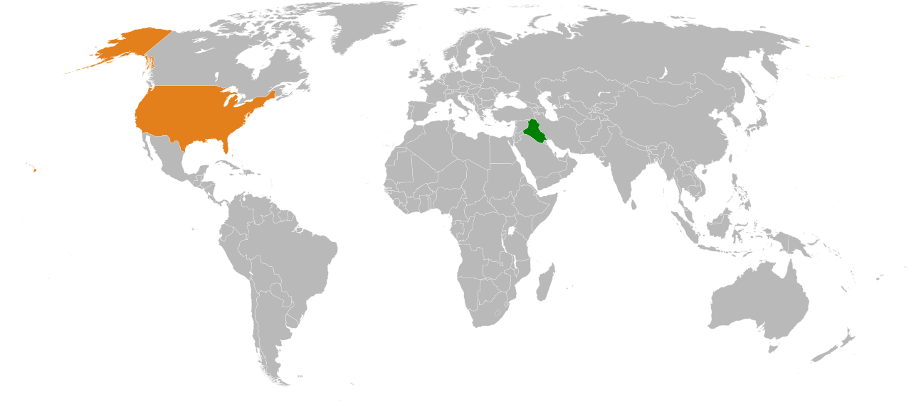
United States invades Iraq (2004)
Economic sanctions on Iraq
Manufacturing of weapons of mass destruction
Support for terrorist groups
Hindering UN inspections
US ultimatum of Saddam leaving Iraq (refusal to comply)
Restoring order- guerrilla warfare

Slide 14
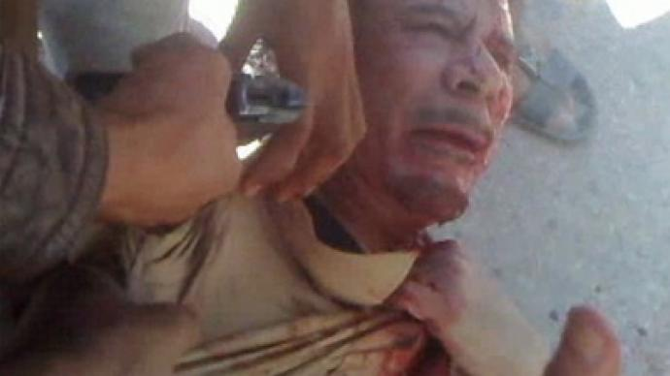
Arab Spring
Muammar Gaddafi executed by rebels in streets of Sirte, Libya
Revolutionary trend in Arab World beginning in 2010--Tunisian Revolution
Spread to Egypt Libya Syria and others
Tunisian Revolution response to corrupt government, lack of democratic freedoms
Ended rule of long-time president Ben Ali and created a refined parliamentary system w/ democratic elections
Egyptian Revolution- political corruption/lack of freedoms
Resulted in overthrow of government and temporary control by military--government still forming today
Libyan revolution- overthrow of government and leader Muammar Gaddafi, who had been in power for 40 years, by revolutionary rebels
Created path for new government-- National Transitional Council
Syria- protests for democratic reforms began 2011
Led to Civil War and intense fighting between various ethnic military groups, which continues today.

Slide 15
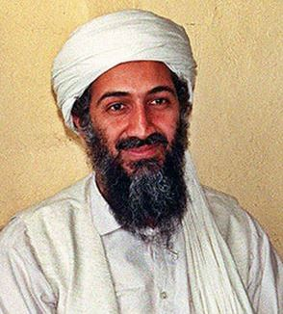
Osama bin Laden Killed (2011)
May 02, 2011 in Abbottabad, Pakistan
US: symbol of victory in terrorism fight/ morale booster
“Bring bin Laden to justice dead or alive” -Bush after 9/11
Sends relentless image to al-Qaeda followers (they are unsafe even in Pakistan)
Focus more time on current leaders (not in hiding)
Al- Qaeda operate off bin Laden ideas not specific leadership (hurt, but easily replaced)

Slide 16
Last combat troops leave Iraq (2011)
The Surge (2007)
U.S.-Iraqi agreement under Bush administration
Redefined military activity in Iraq
Timetable for troop withdrawal
Leaking of Military documents
Attempt to keep U.S. troops past 2011, negotiations failed
U.S. military formally declares end of mission in Iraq on December 15, 2011

